Slide 1
Appy Sessions

Slide 2

Infrastructure as code

Slide 3
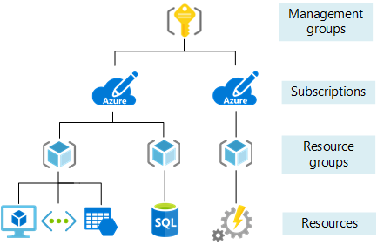
Infrastructure as code: Cloud Resources

Slide 4
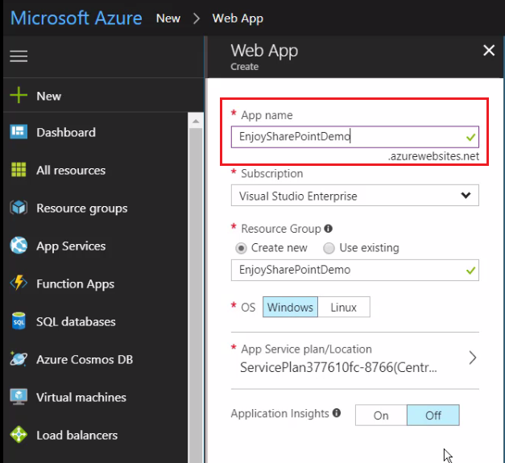

Infrastructure as code: What problem does it solve?

Slide 5
Infrastructure as code: What?
Let the code define
how your cloud looks!!!

Slide 6

Infrastructure as code: Benefits
Reusable
Consistent
Visible
Versioned
…

Slide 7





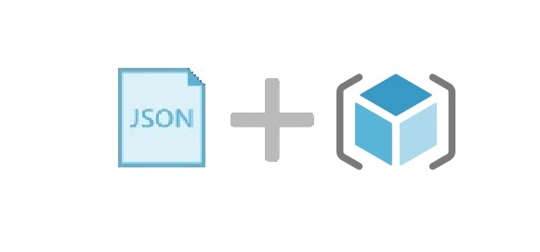





Infrastructure as code: CI/CD
Domain/API/Project code
Build, Test, Deploy
Infrastructure code/templates
Create/Update Cloud infrastructure
Deploy/Provision cloud resource

Slide 8
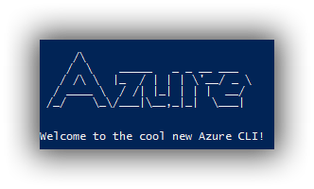


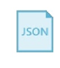

Infrastructure as code: Environment/Templates
Availability Cloud Environment:
Resource group
WebApp (qa, live)
Function app
Storage
etc
Base Templates:
Webapp template
Sqldatabase template,
Network template
Function app template
etc
Use
templates
Create/Update Cloud infrastructure Using
With Custom parameters
Variables:
Environment: QA/Live
Webapp name
Instances
etc
Azure SDK (C#)
Deploy/Provision cloud

Slide 9
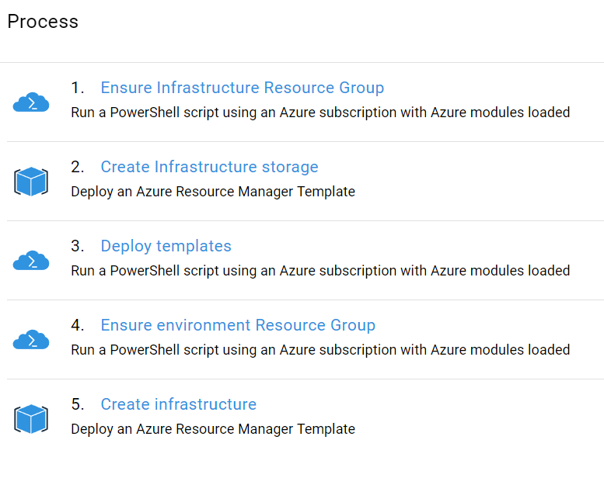
Infrastructure as code: Octopus Infrastructure Process

Slide 10
Infrastructure as code: Types
Azure ARM templates
Terraform
Azure Management SDK (C#)
…

Slide 11
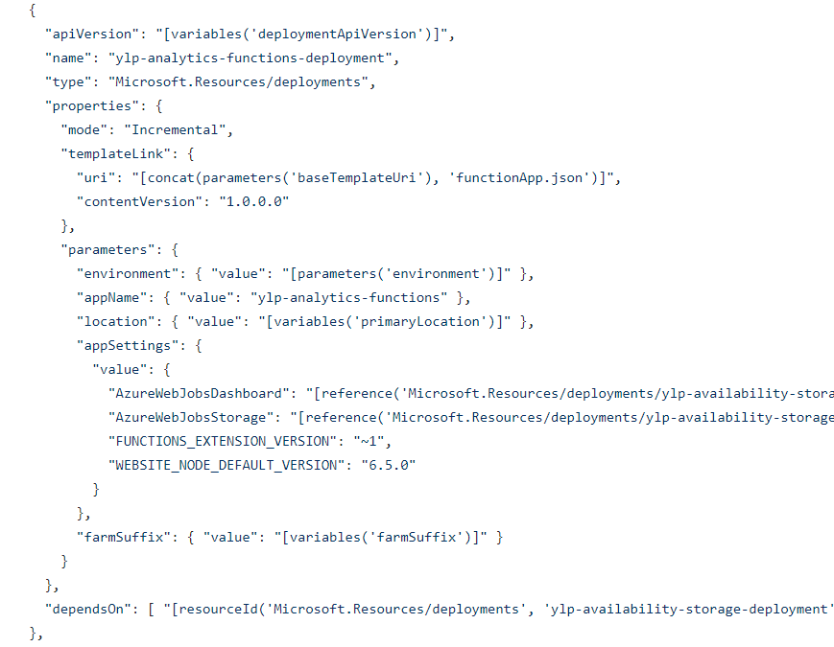
Infrastructure as code: Azure ARM Templates
Environment Infrastructure: availability.json

Slide 12
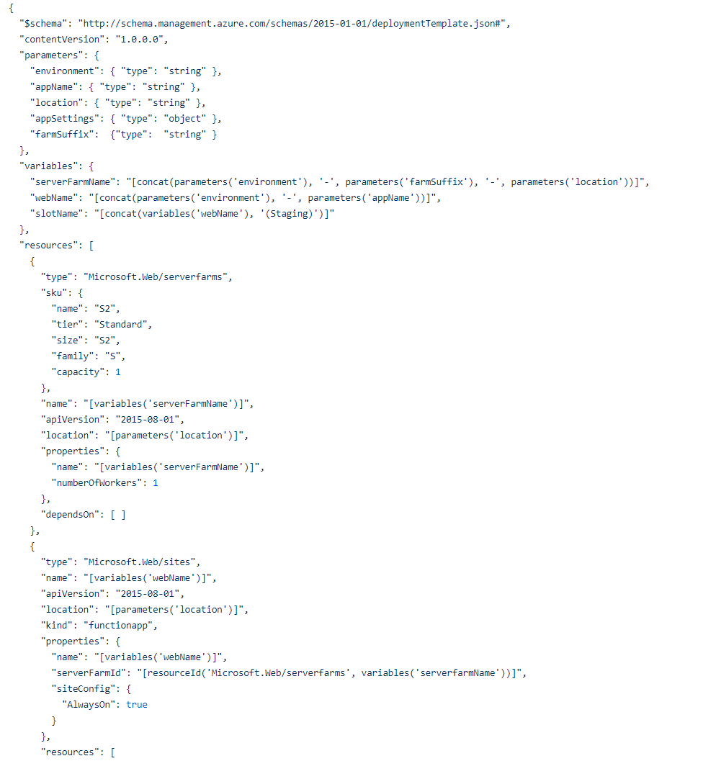
Infrastructure as code: Azure ARM Templates
Base Template: functionApp.json

Slide 13
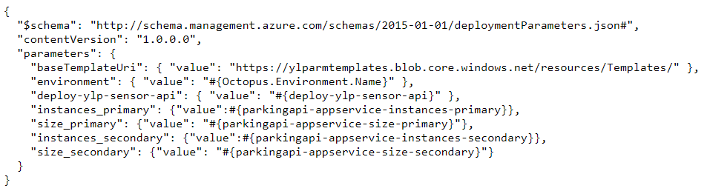
Infrastructure as code: Azure ARM Templates
Environment Parameters:
availability-parameters.json

Slide 14
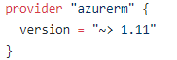
Infrastructure as code: Terraform
Cloud Provider: providers.tf

Slide 15
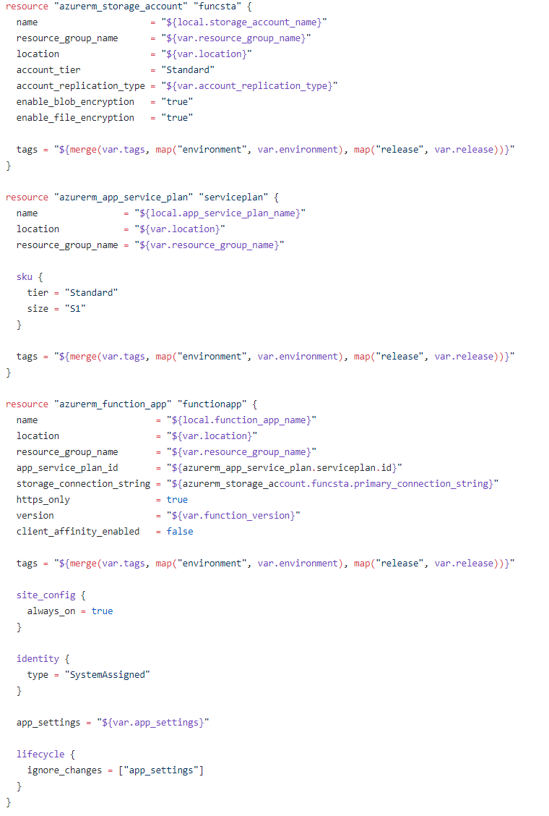
Infrastructure as code: Terraform
Base Templates: templates.tf

Slide 16
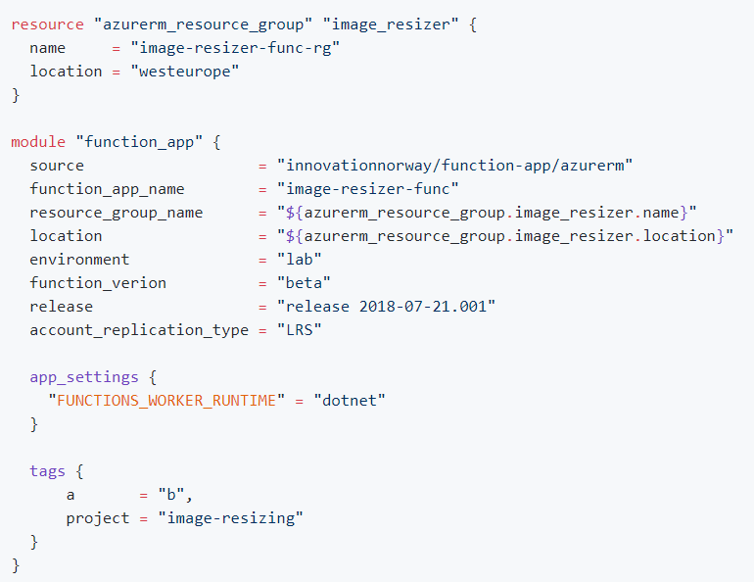
Infrastructure as code: Terraform
Environment : example-function.tf

Slide 17
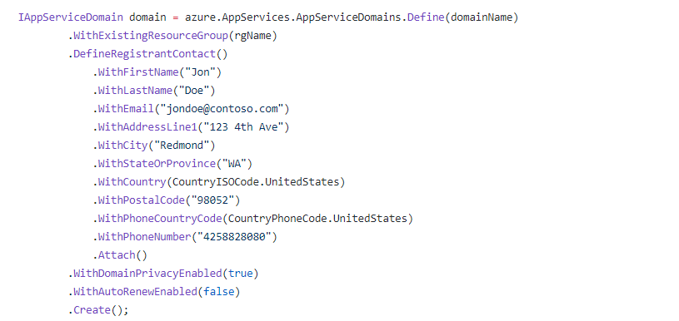
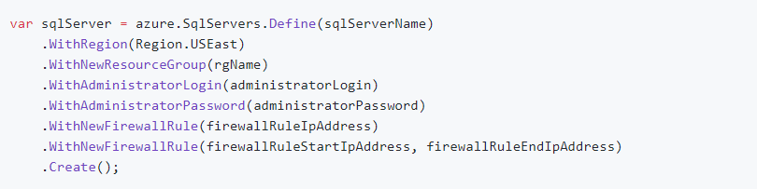
Infrastructure as code: Azure Management SDK (C#)
C# Fluent Definition:

Slide 18
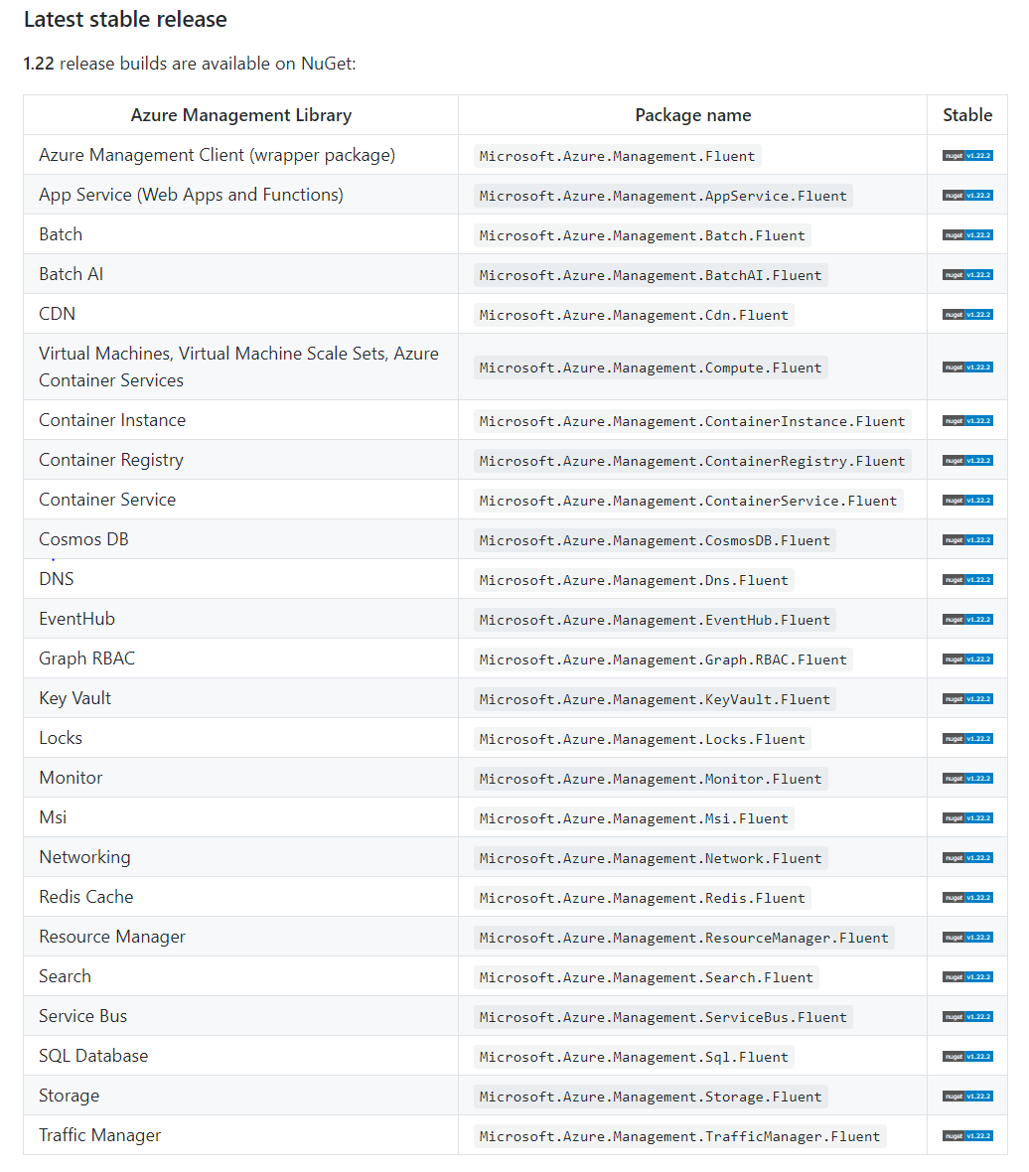
Infrastructure as code: Azure Management SDK (C#)

Slide 19
Infrastructure as code: Azure Management SDK (C#)
Demo

Slide 20
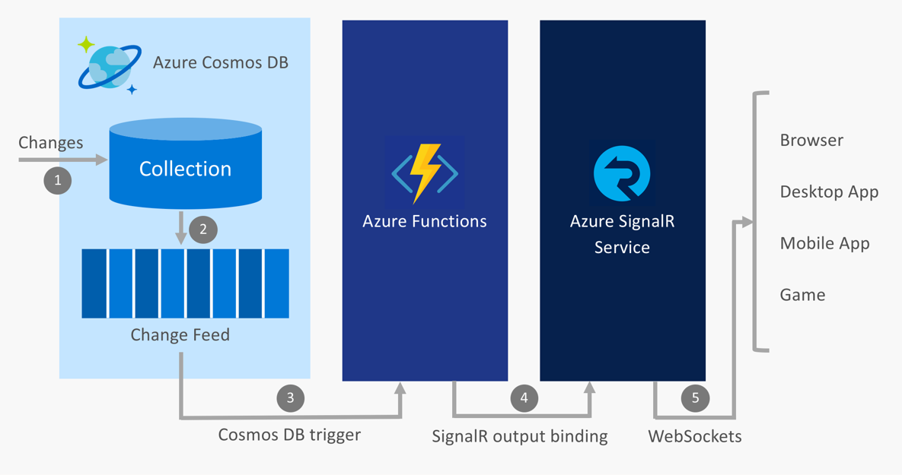


Infrastructure as code: Azure Management SDK (C#)
Durable
Normal
0
Service Bus trigger

Slide 21

Infrastructure as code: Demo
What resources do we need?

Slide 22
Infrastructure as code: Demo
What resources do we need?
Resource group
Azure storage
Cosmos Account
Cosmos Database
Cosmos Collection
Azure App Service (Consumption)
Azure function App
Azure SignalR Service

Slide 23

Infrastructure as code: Demo

Slide 24

Infrastructure as code: And the winner is?

Slide 25

Second Part?

Slide 26
Second Part?
Durable
Normal
0
Service Bus trigger

Slide 27

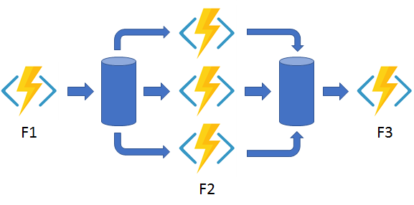
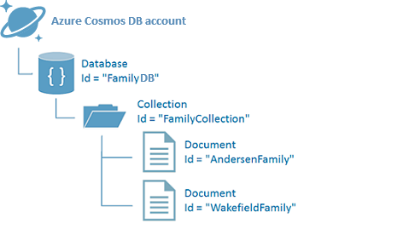


Second Part?

Slide 28
Questions & Debate?

Slide 29
Thanks!

